Slide 1

Challenge i TORONTO bikeshare ANALYSIS
Presented by:
Rayhan ozzy ertarto
Tubagus reja
(KEL. 11)

Slide 2
BUSINESS UNDERSTANDING
What percentage of bikes are returned to its initial location?
How many bikeshare trips usually visit more than just start/end points, but visited some other points before the end of the day?

Slide 3
ANALYTIC APPROACH
Exploratory Data Analysis (EDA) or statistical analysis
Data visualization

Slide 4
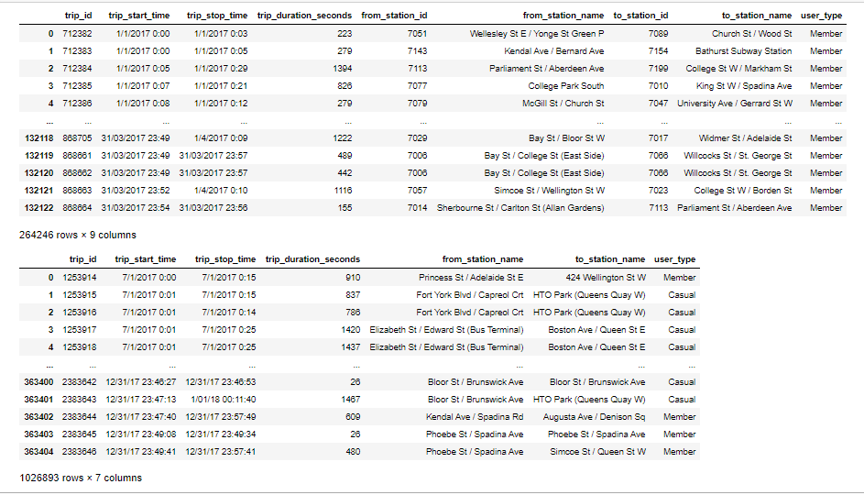
DATA UNDERSTANDING
We use data from Bikeshare on 2017.
As you can see, q1 and q2 data set have the same number of columns. so was q3 and q4 data set. But q1,q2 and q3,q4 have different number of columns. So we will concatenate q1 and q2. Then we will concatenate q3 and q4 also.

Slide 5
(Q.1) Find out what percentage of bikes are returned to its initial location?
We will find if the bikes were returned to it's initial location using from_station_id, to_station_id, from_station_name and to_station_name feature in each data set. If each feature is common, so the bikes were returned to it's initial location.

Slide 6
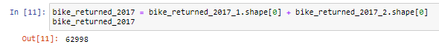
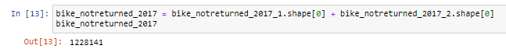
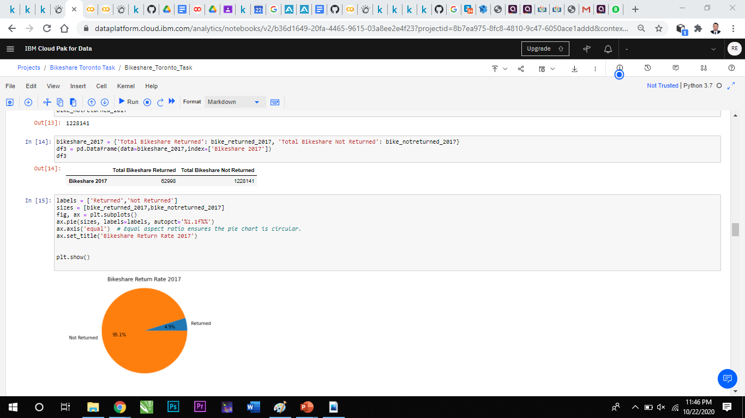
As we can see, we can get the BikeShare Return rate that there are 4.9% of bike that returned to its original location and 96.1% not returned back.

Slide 7
(Q.2) How many bikeshare trips usually visit more than just start/end points, but visited some other points before the end of the day?
Now we can assume if each trip id use more time than the average trip duration then the trip visited more than one point, so we need to find every single bikeshare trip which have trip duration greater than average trip duration in each day.

Slide 8
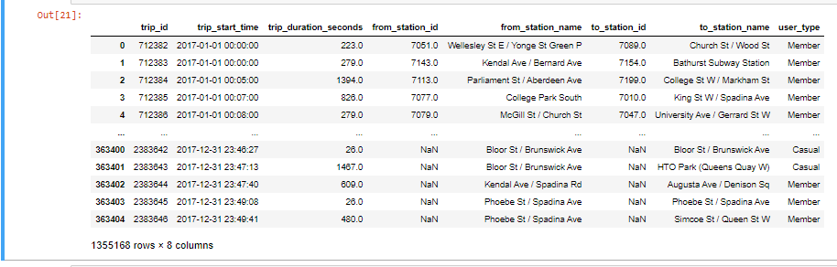
Because we want to find how many bikeshare trips usually visited some other points, we need to convert the time feature in pandas data frame. Below we will convert trip_start_time column into pandas datetime type so we can clasify the row into day value like Monday, Tuesday, Wednesday, and so on.

Slide 9
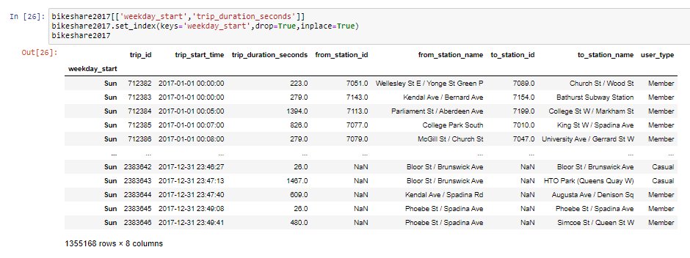
Now we have the feature of day in the dataset. Since we want to analyze how much bikeshare trip visited more than one point in a day using comparison between trip duration second each trip, so we could drop every column than unusefull for this. We just need column weekday_start and trip_duration_seconds

Slide 10
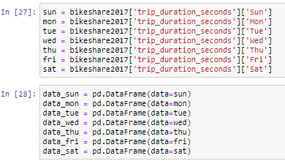
We will separate them into 7 dataframe which represent each day in weeks. Each data frame has information such day and trip duration in second.

Slide 11
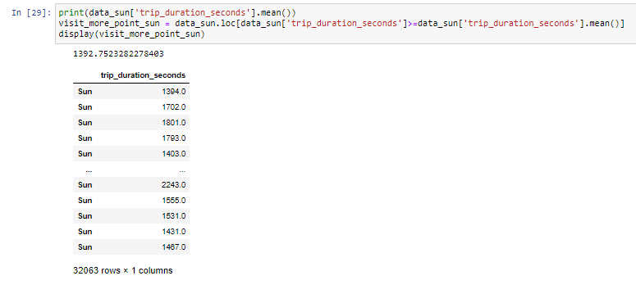
Now we will do a simple selection. We will select data include trip duration in second which larger than the average/mean trip duration in every different day. First we will do selection for Sunday and so on till Monday.

Slide 12
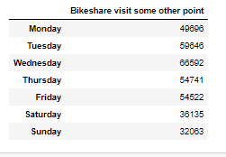
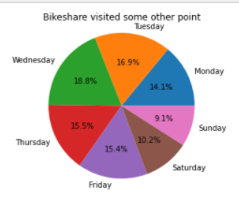
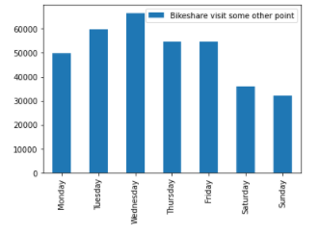
Last, we will make data frame contains days in a week and bikeshare which visited some other point.

Slide 13
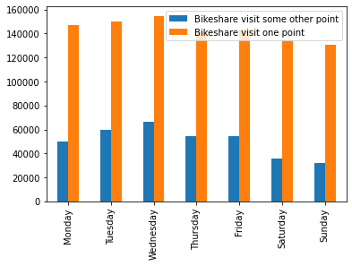
Comparison
This figure compare bikeshare which visitted one point vs visitted some other point

Slide 14
CONCLUSION
There are only 4.9% of bike that returned to its original location and and 96.1% not returned back.
We have 49696 bikeshare which visited some other point in Monday, 59646 bikeshare in Tuesday, 66592 bikeshare in Wednesday, 54741 bikeshare in Thursday, 54522 bikeshare in Friday, 36135 bikeshare in Saturday, and 32063 bikeshare in Sunday.

Slide 15

NOTEBOOK
https://dataplatform.cloud.ibm.com/analytics/notebooks/v2/b36d1649-20fa-4465-9615-03a8ee2e4f23?projectid=8b7ea975-8fc8-4810-9c47-6050ace1addd&context=cpdaas

Slide 16

BUHAN PIAN Ada yang handak BEtakun kah? ☺ Artinya: Kalian ada yang mau bertanya kah?

